Slide 1
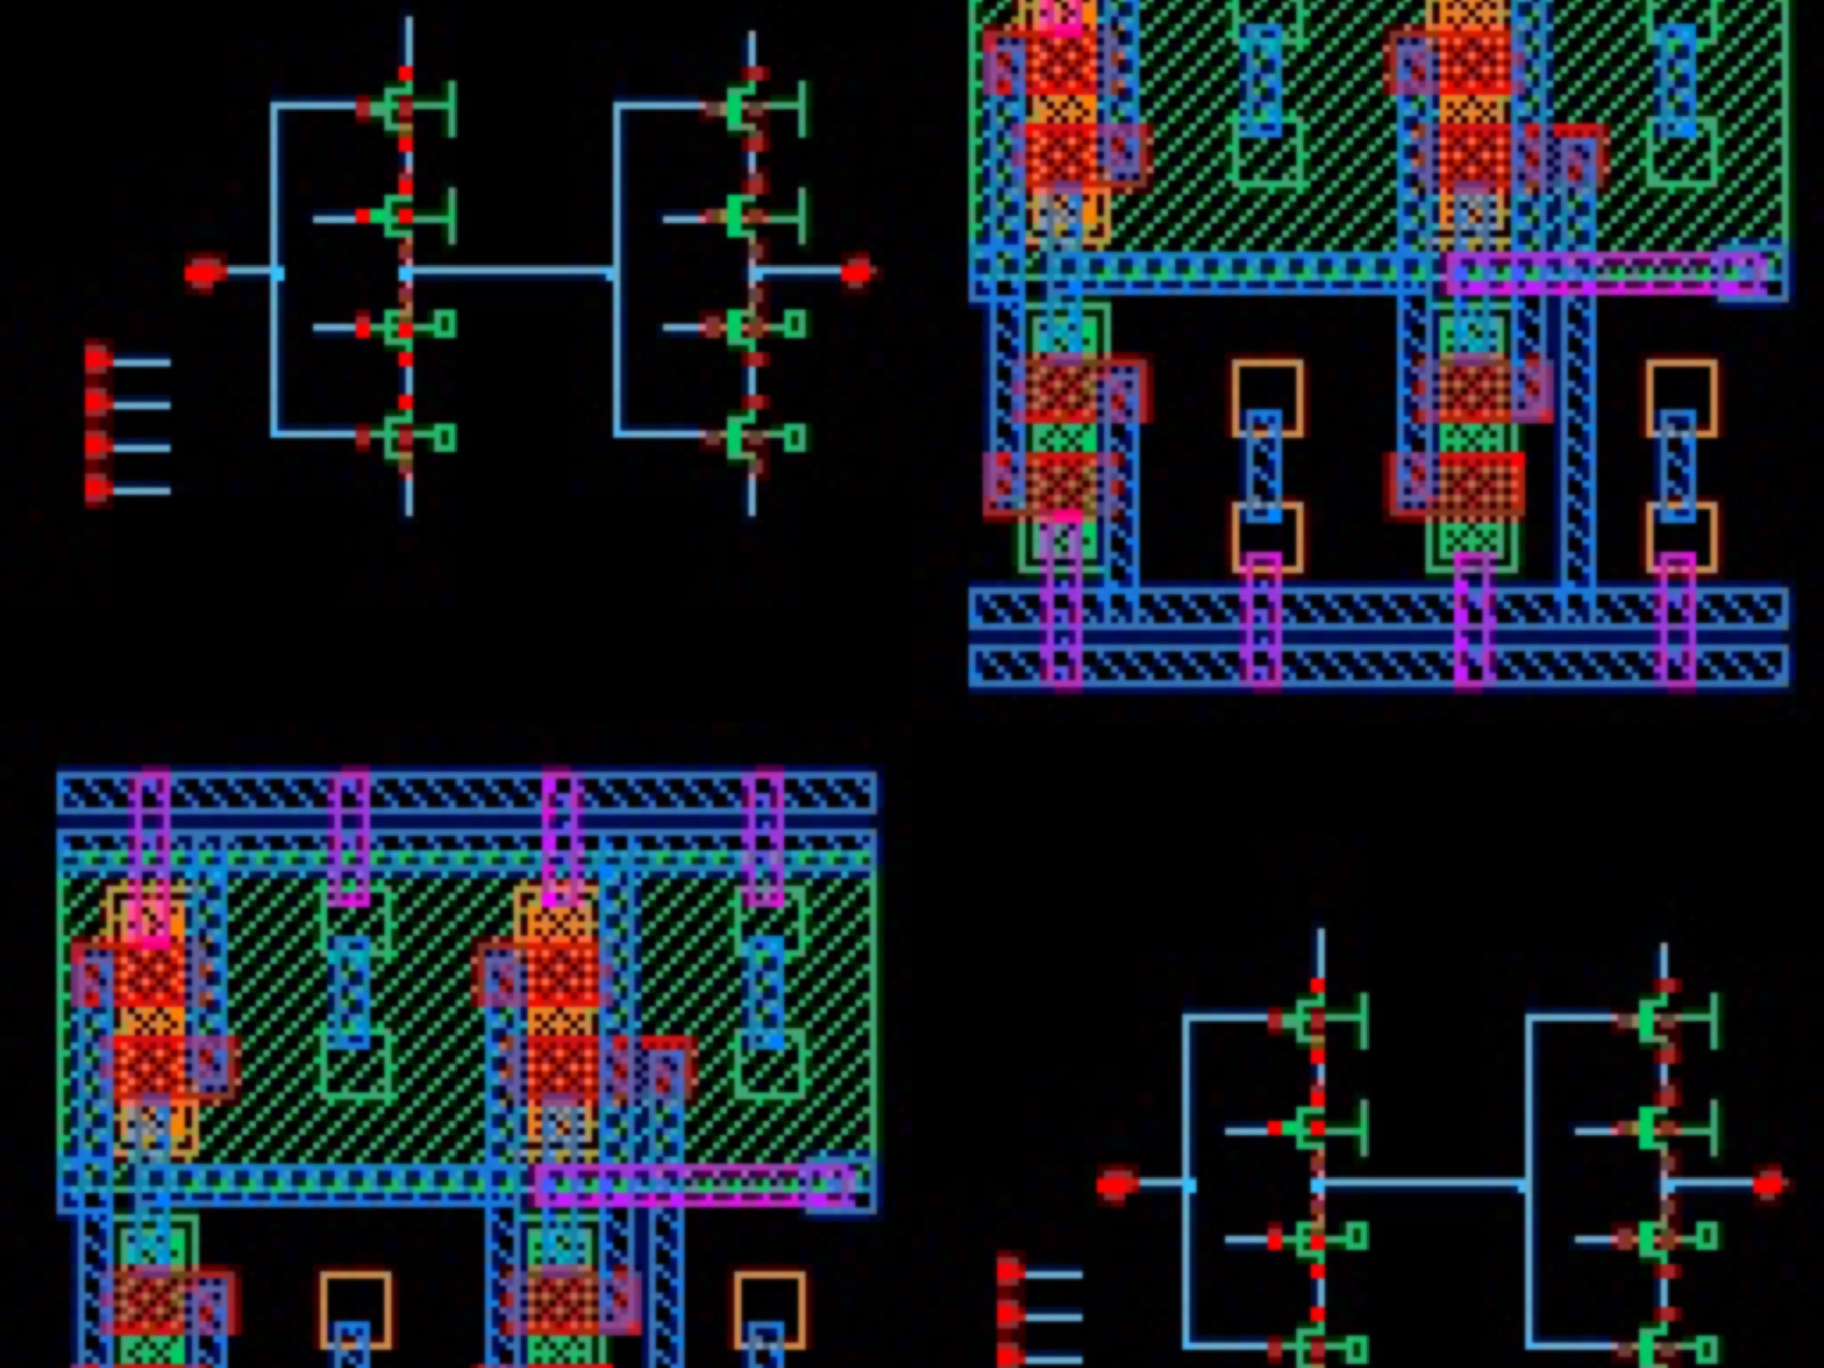
C2MOS Latch – Shift Register
Alexander Shen, Brian Zhou, Hayley Chu

Slide 2
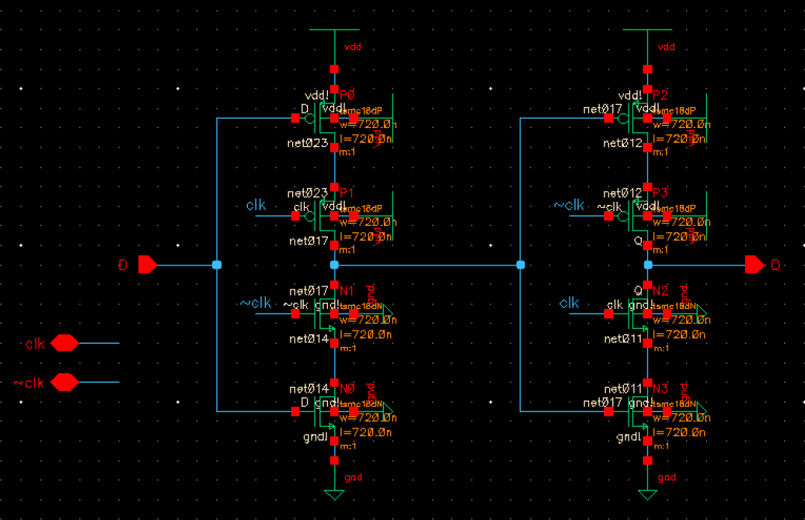
C2MOS Latch Schematic
Alexander Shen, Brian Zhou, Hayley Chu
Johns Hopkins University | Department of Electrical and Computer Engineering | Baltimore, MD
This is the schematic for the C2MOS Latch.
Because they are manufactured on a wafer, all transistors share the same bulk. We learnt that to reduce bulk effect, we have to tie source to bulk. But because all transistors will share the same bulk, we had to avoid this by tying every bulk to ground/ lowest potential. For NMOS its VSS and for PMOS its VDD. Although this introduces bulk effect, in a digital circuit if you introduce a strong enough gate voltage we can mitigate that.
To maintain a clean schematic without wires overlapping, I chose to use pins to define the signals and label the wires on the schematic.
For the layout vs schematic checks to work properly, I moved the inverter for the clock signal and capacitors to my simulation schematic which is shown on the next slide.
Contributions
Alexander Shen

Slide 3
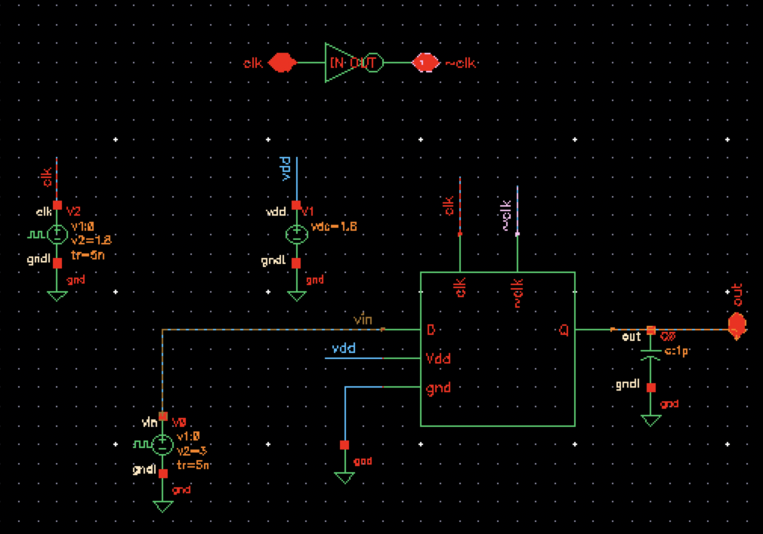
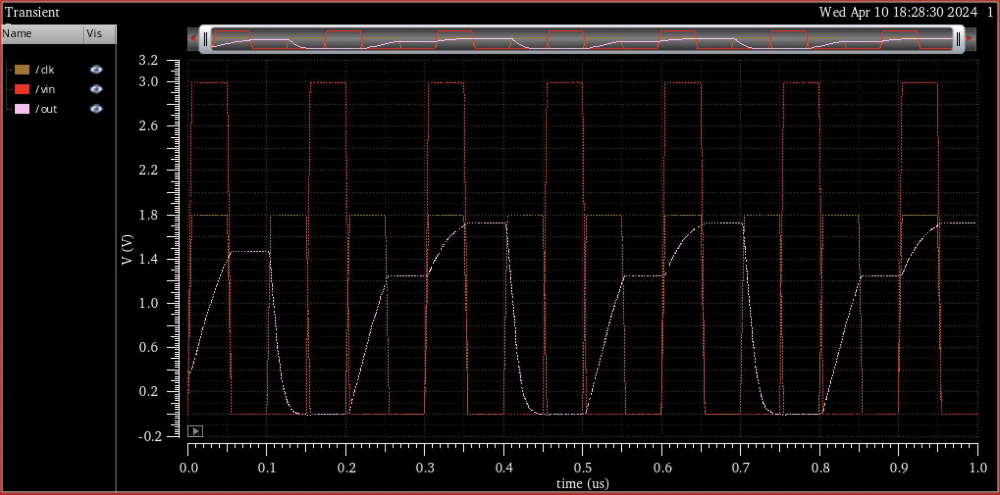
Simulation for one C2MOS Latch
Alexander Shen, Brian Zhou, Hayley Chu
Johns Hopkins University | Department of Electrical and Computer Engineering | Baltimore, MD
This is the simulation schematic and timing diagram for the C2MOS Latch.
To make sure the Layout Versus Schematic is consistent, the capacitor and inverter are both moved into this simulation schematic.
I chose to use a rectangle as the symbol shape because it is basically a D Latch and they usually have a rectangle shape.
The timing diagram shows the clock, vin, and vout voltages. I gave the Clk a period of 100 nanoseconds and the vin signal a period of 150 nanoseconds so that They will only overlap every 300 nanoseconds and show that the latch is working as intended; vout only gets the vin value when Clk is high.
Contributions
Alexander Shen

Slide 4
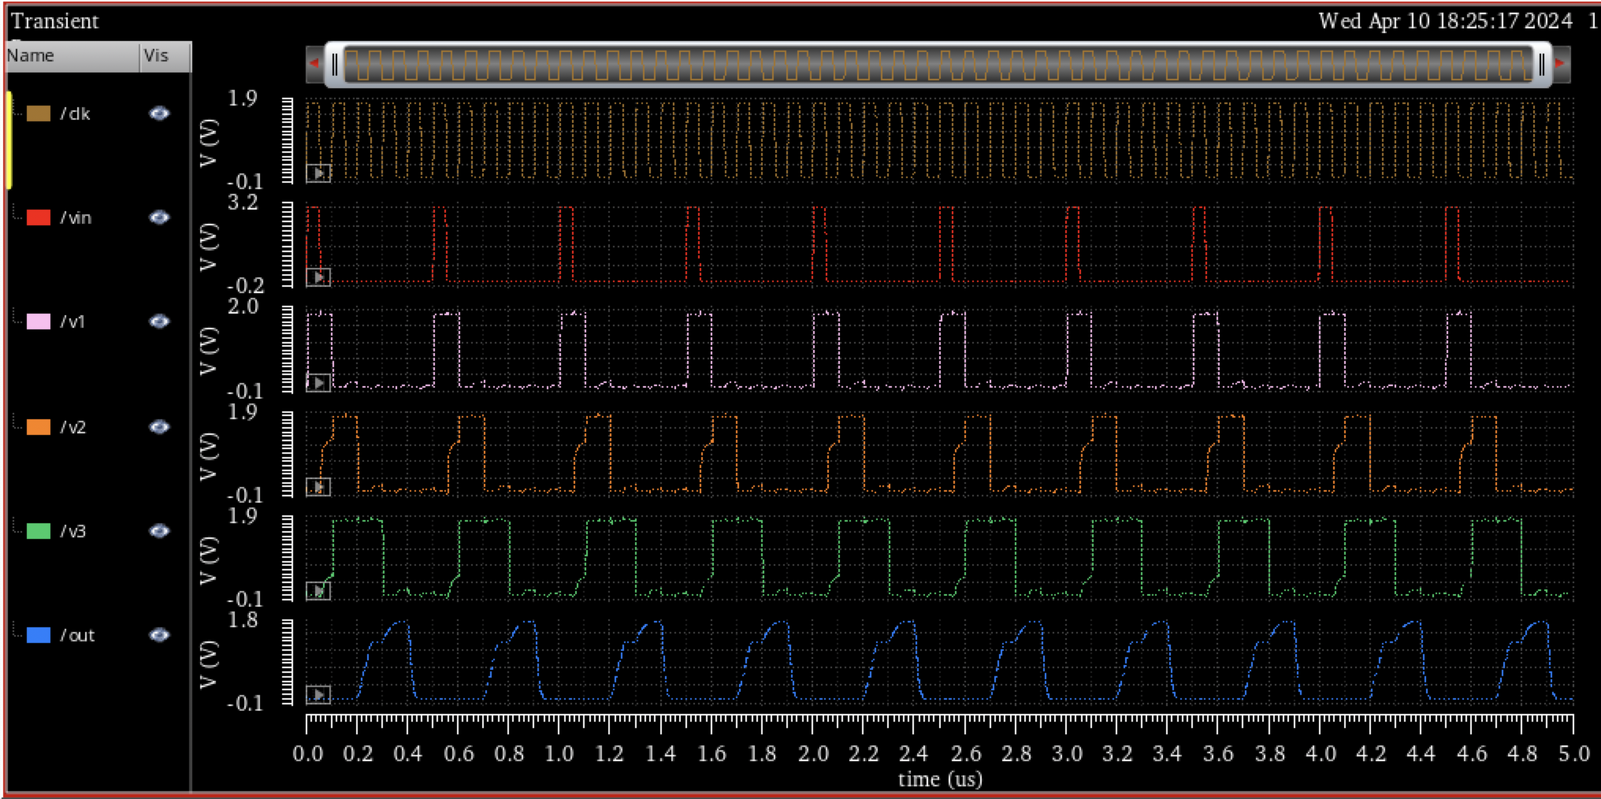
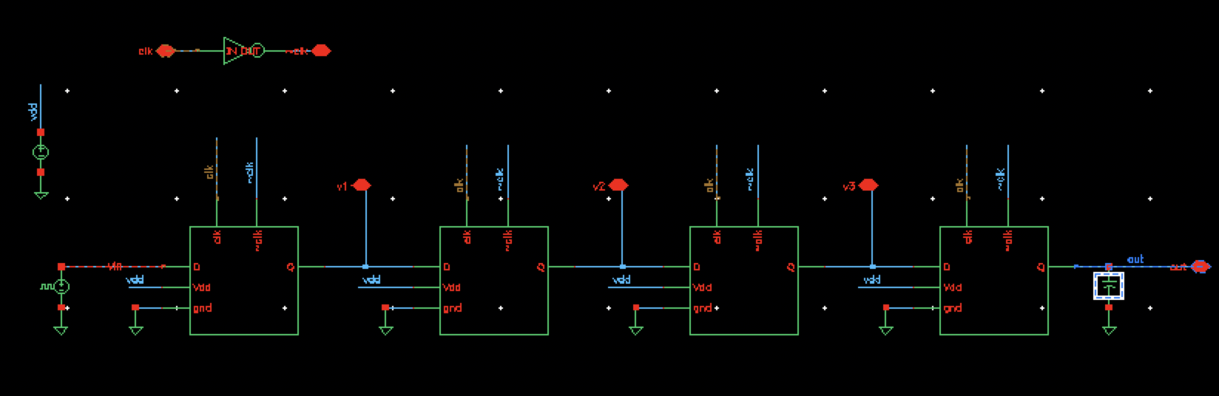
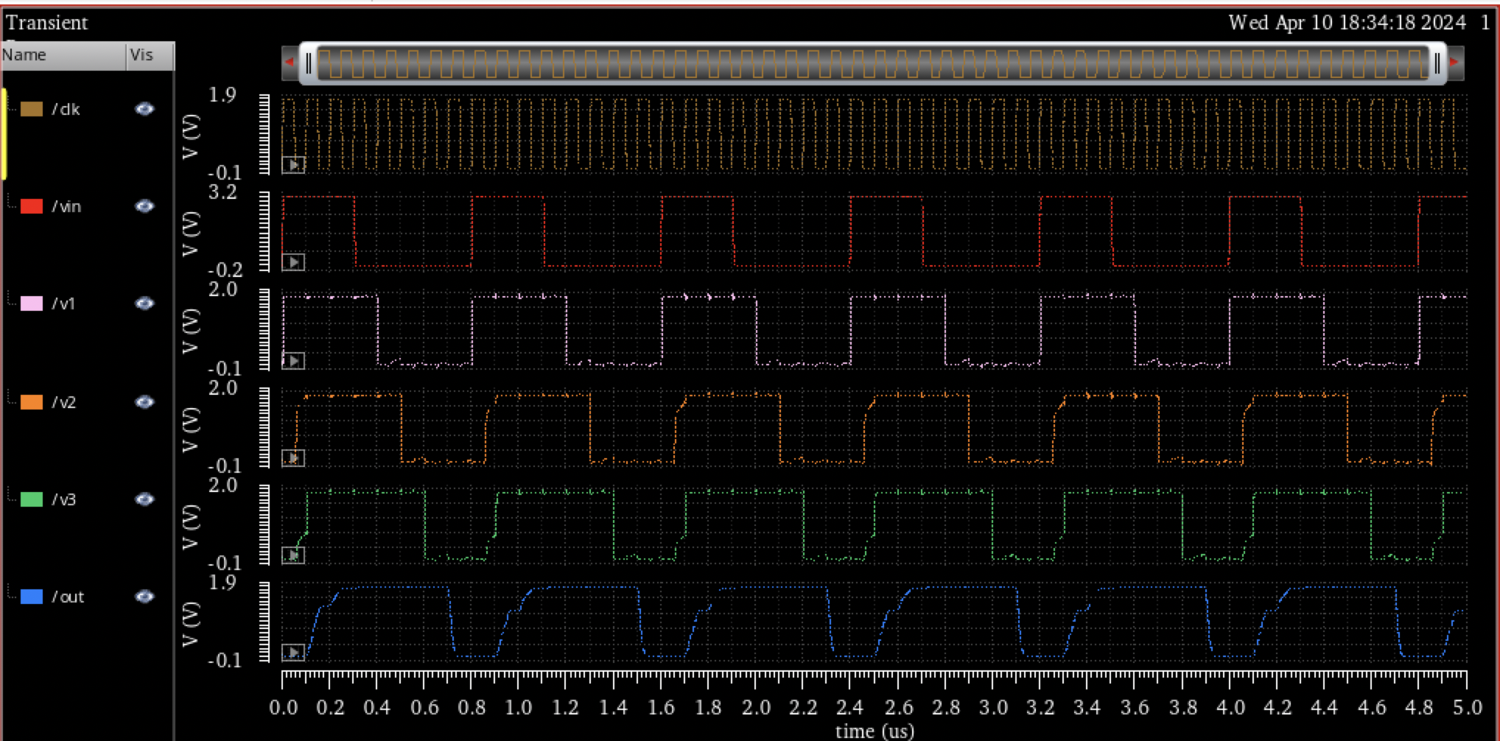
Simulation for Shift Register
Alexander Shen, Brian Zhou, Hayley Chu
Johns Hopkins University | Department of Electrical and Computer Engineering | Baltimore, MD
This is the simulation schematic and timing diagrams for the shift register made from C2MOS Latches.
I tested the vin with a pulse width of 300 nanoseconds and period of 800 nanoseconds as well as pulse width 45 nanoseconds and period 150 nanoseconds (same as latch test earlier).
It demonstrates shift register behavior.
Contributions
Alexander Shen

Slide 5
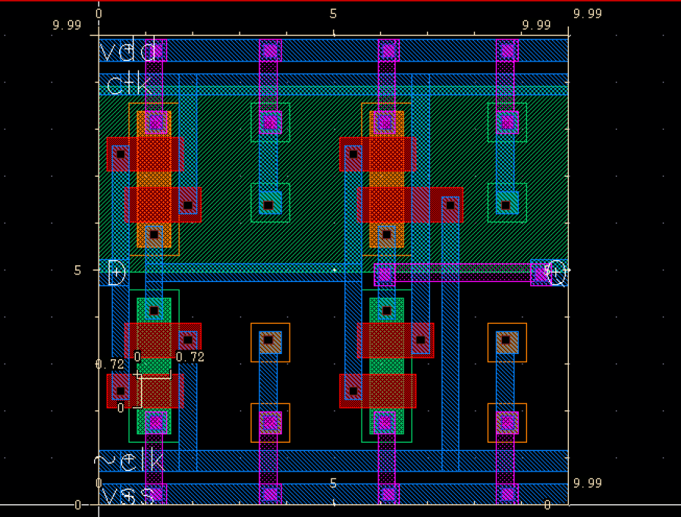
C2MOS latch layout (without capacitors)
Alexander Shen, Brian Zhou, Hayley Chu
Johns Hopkins University | Department of Electrical and Computer Engineering | Baltimore, MD
This is the layout that doesn’t include capacitors. In this version, symmetry and readability is prioritized.
Components are stacked close together so that there would be sufficient space for extra components (i.e. capacitors)
Evenly spaced-out bulk terminals are added to ensure that the bulk has uniform voltage.
Contributions
Brian Zhou

Slide 6
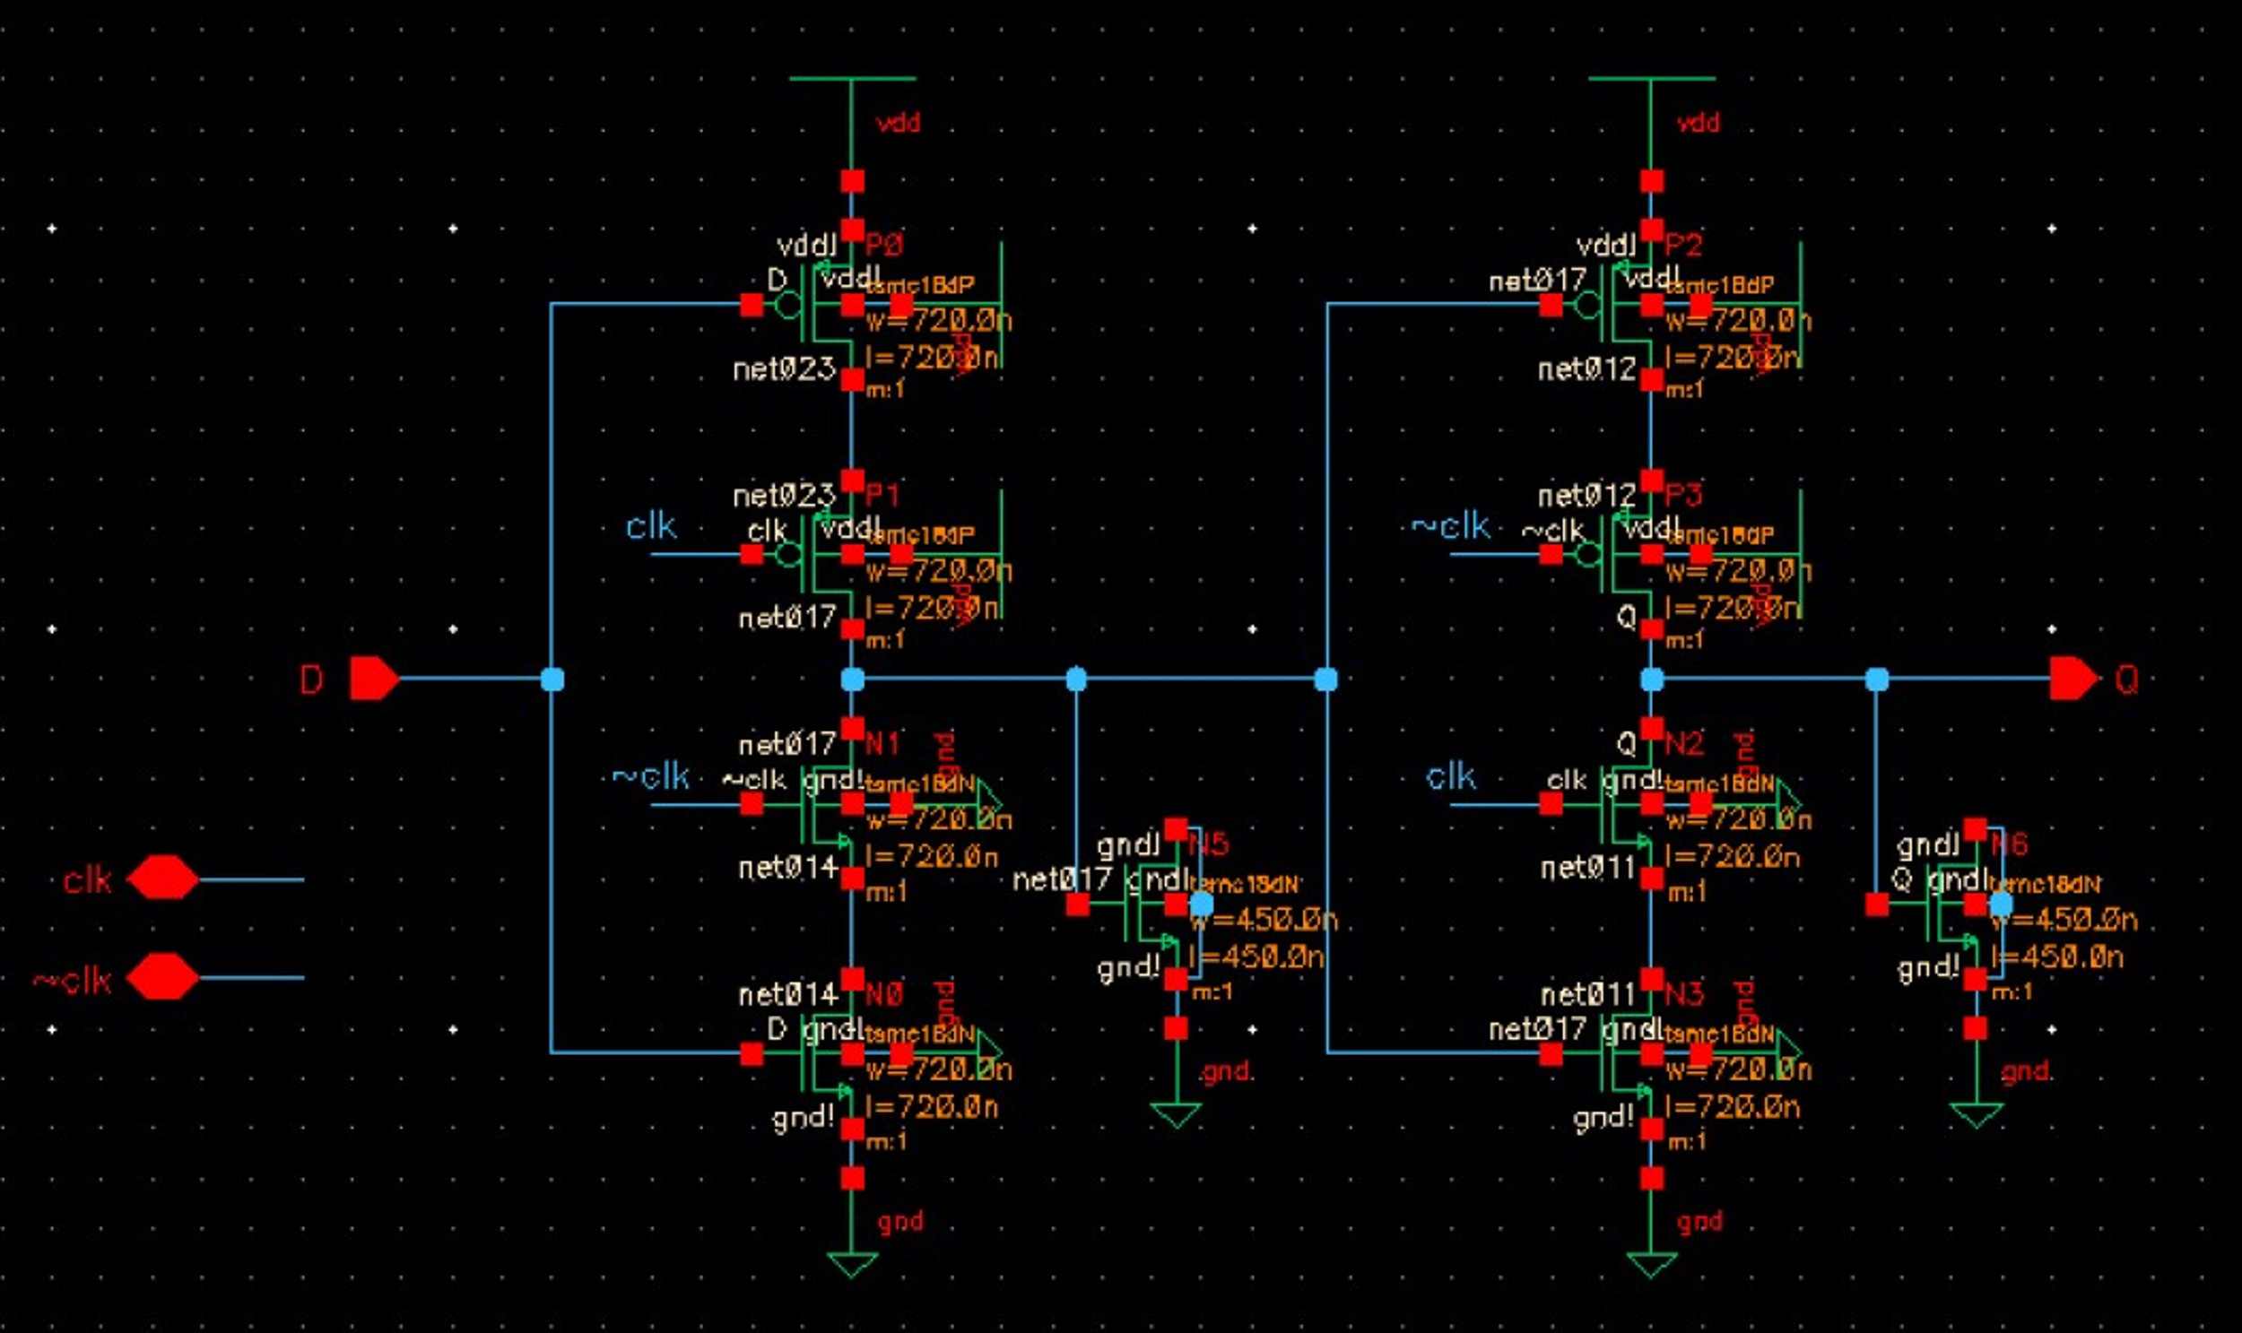
C2MOS Latch Schematic (With capacitor)
Alexander Shen, Brian Zhou, Hayley Chu
Johns Hopkins University | Department of Electrical and Computer Engineering | Baltimore, MD
This is the schematic for the C2MOS Latch, with NMOS as capacitors.
Capacitors are implemented with NMOS by shorting source and drain, using the gate capacitance as the capacitor.
The dimensions of the NMOS for capacitors was determined based on the space available on the layout (450 nm x 450 nm), but further optimization can be done.
Contributions
Brian Zhou

Slide 7
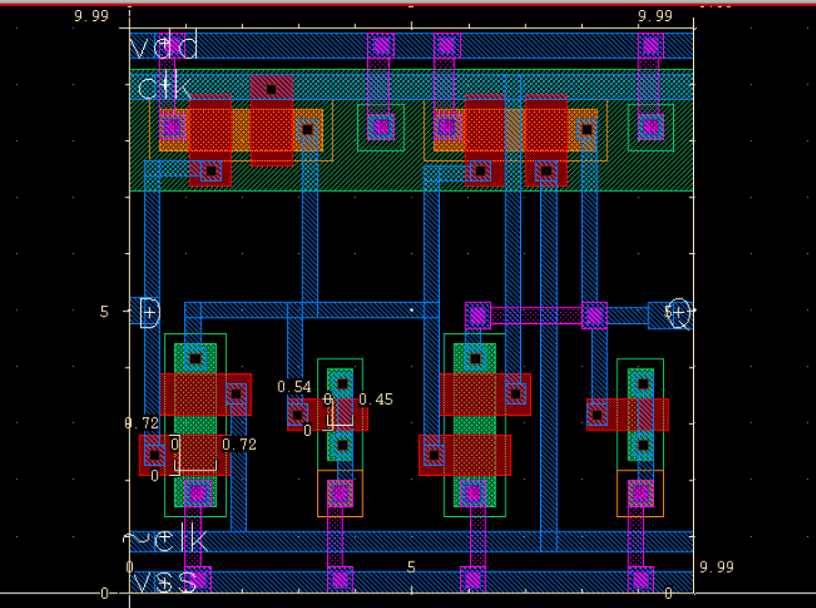
C2MOS Latch Layout with capacitors
Alexander Shen, Brian Zhou, Hayley Chu
Johns Hopkins University | Department of Electrical and Computer Engineering | Baltimore, MD
This is the layout that includes capacitors implemented with NMOS.
Furthermore, PMOS are laid horizontally to reduce the dimensions of the n well, which may reduce the cost of manufacturing.
More space may be saved by using other metal layers, which could allow for bigger NMOS capacitors.
This layout also passes DRC and LVS checks with no error.
Contributions
Brian Zhou

Slide 8
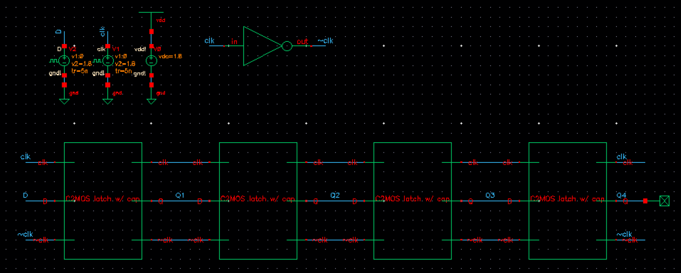
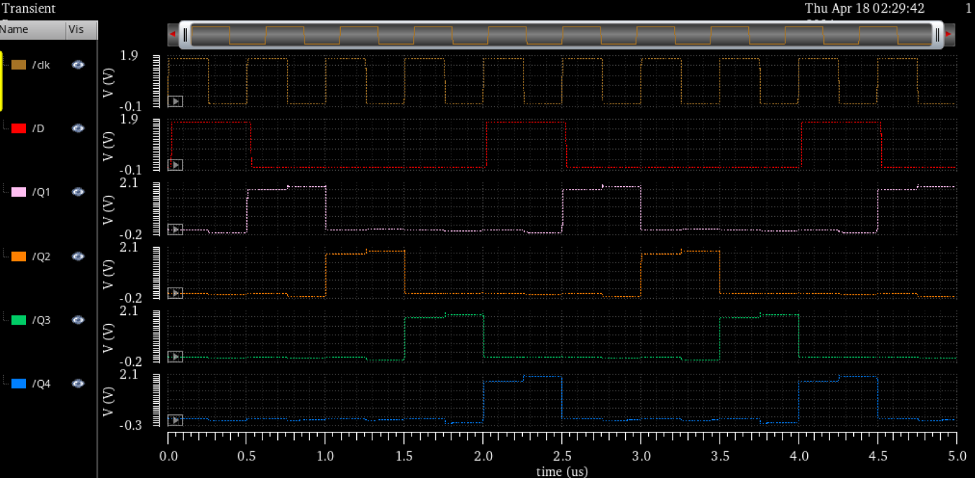
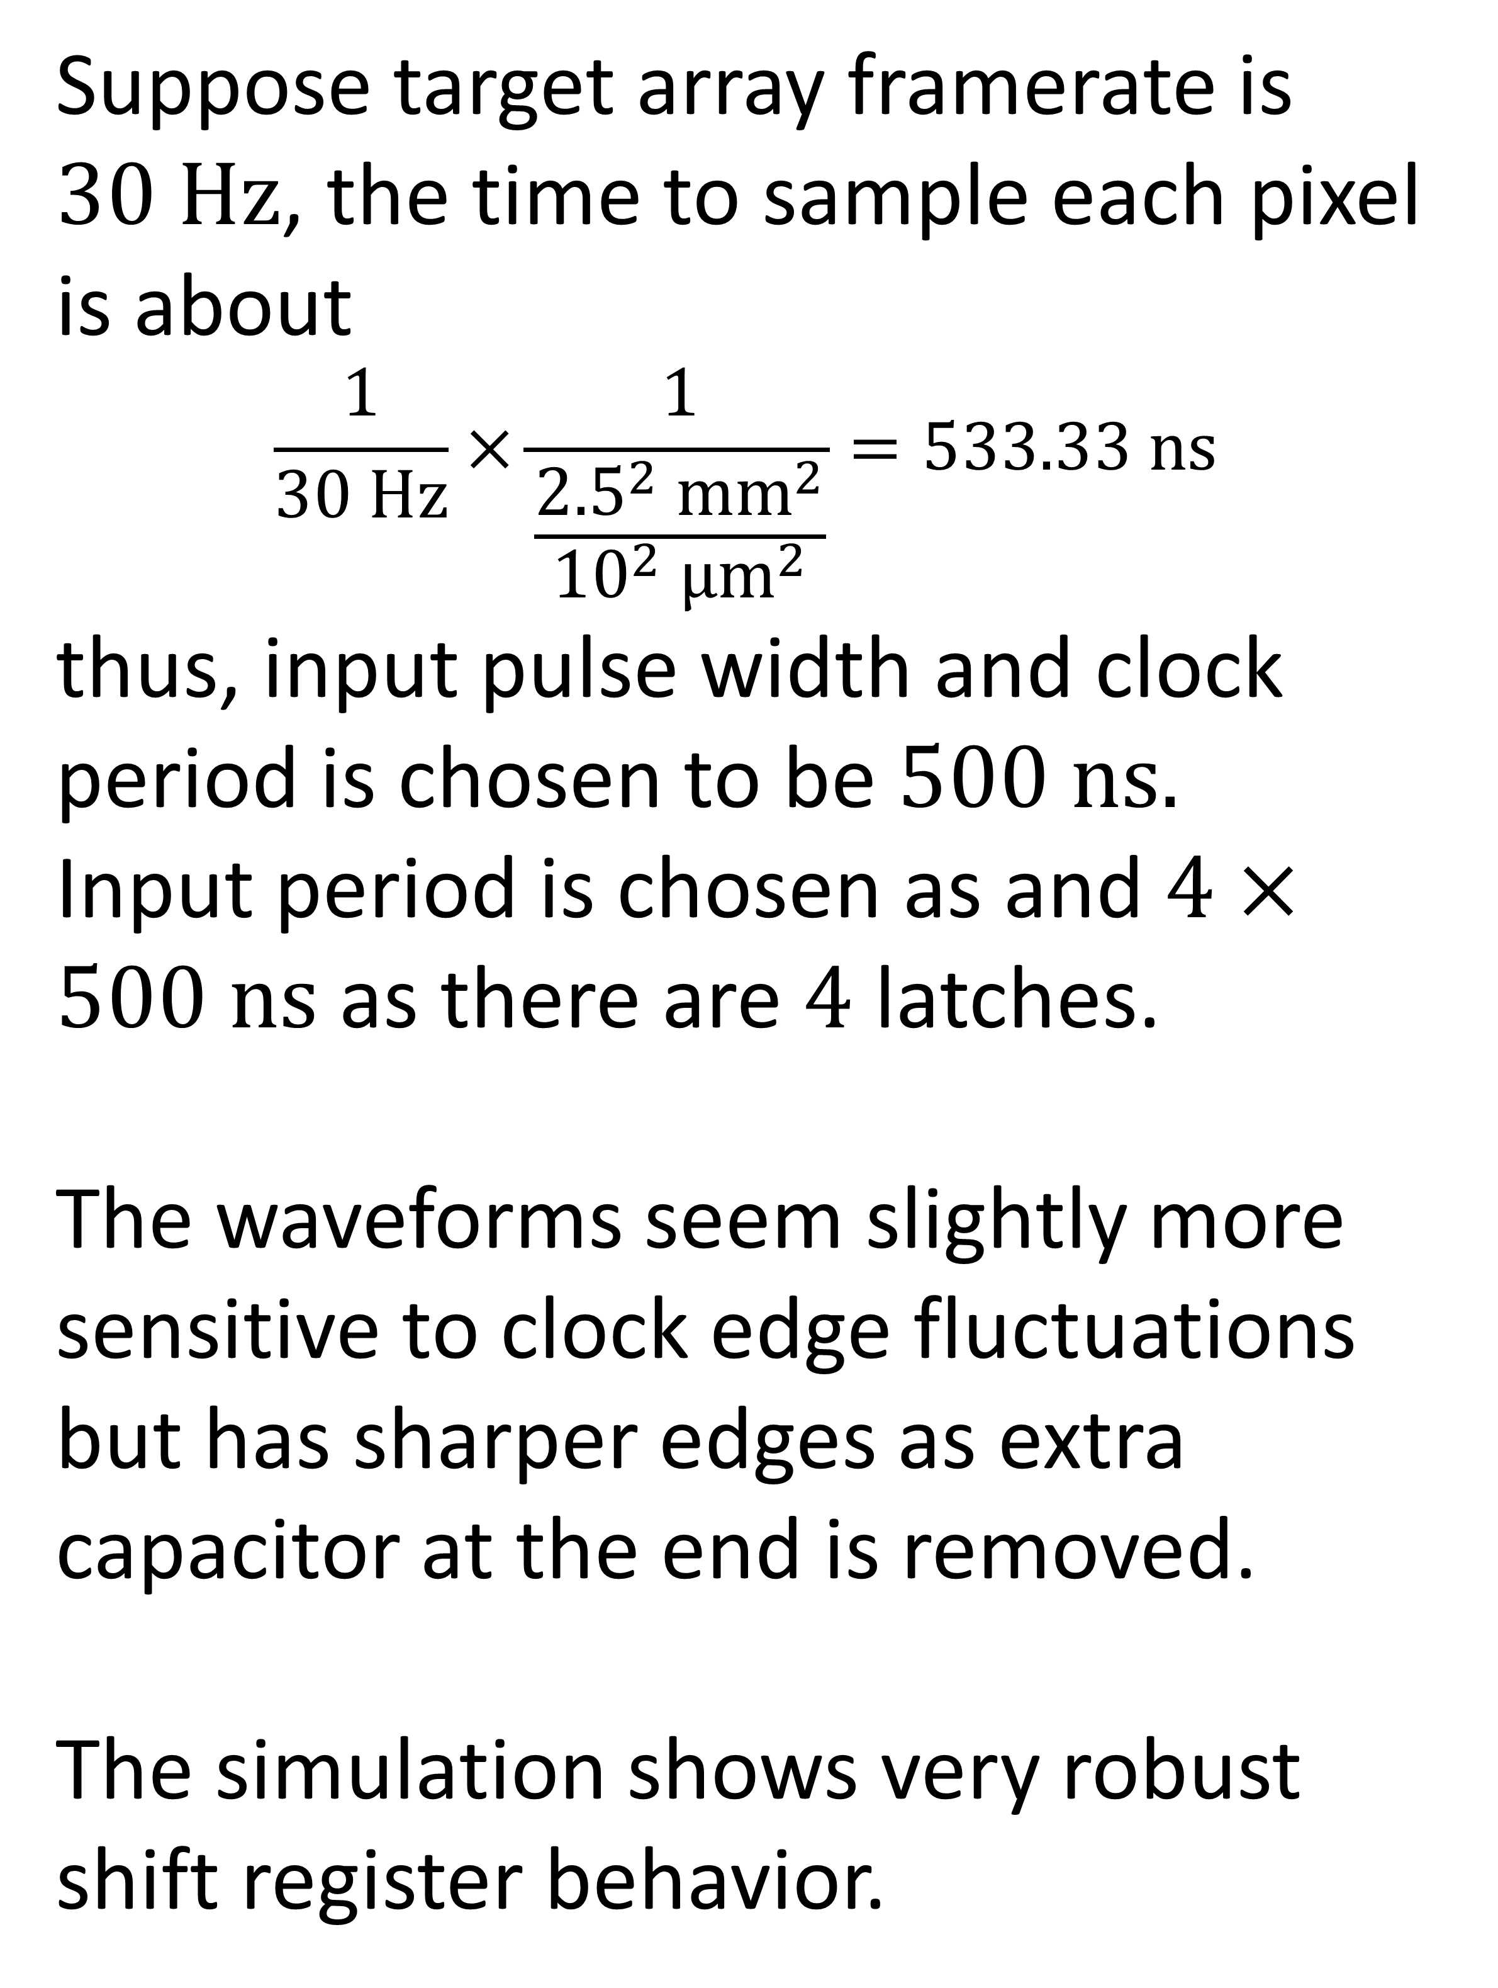
Simulation for Shift Register (latch with capacitors)
Alexander Shen, Brian Zhou, Hayley Chu
Johns Hopkins University | Department of Electrical and Computer Engineering | Baltimore, MD
Suppose target array framerate is $30 Hz$, the time to sample each pixel is about
$$\frac{1}{30 Hz}×\frac{1}{\frac{{2.5}^{2} {mm}^{2}}{{10}^{2} {μm}^{2}}}=533.33 ns$$
thus, input pulse width and clock period is chosen to be $500 ns.$
Input period is chosen as and $4×500 ns$ as there are $4$ latches.
The waveforms seem slightly more sensitive to clock edge fluctuations but has sharper edges as extra capacitor at the end is removed. The simulation shows very robust shift register behavior.
Contributions
Brian Zhou

Slide 9
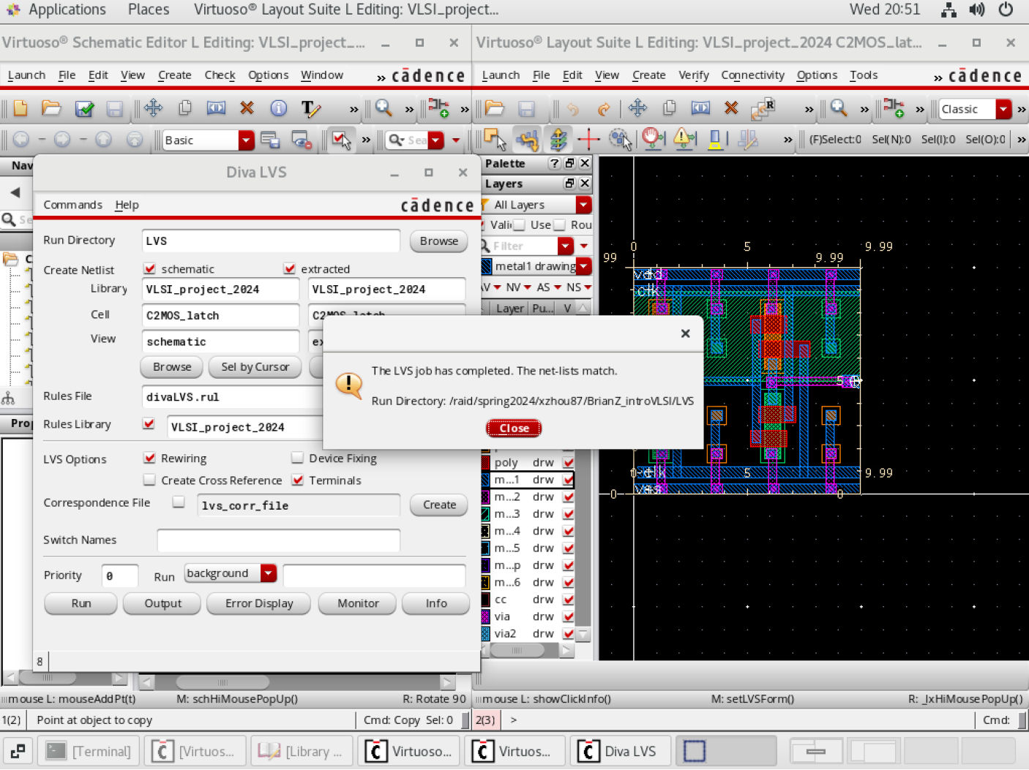
Layout testing
Alexander Shen, Brian Zhou, Hayley Chu
Johns Hopkins University | Department of Electrical and Computer Engineering | Baltimore, MD
Design rule check (DRC):
I mostly only needed to change the dimensions of the instances to make sure the components weren’t overlapping.
I learned that to connect between an active layer to metal layer 2, we need both the cc and via.
Layout-vs-schematic (LVS): I needed to make sure all the terminals have exactly the same name as they are on the layout, and all the nodes are of the same type (input, output, input/output) between the schematic and the layout.
Contributions
Hayley Chu

Slide 10
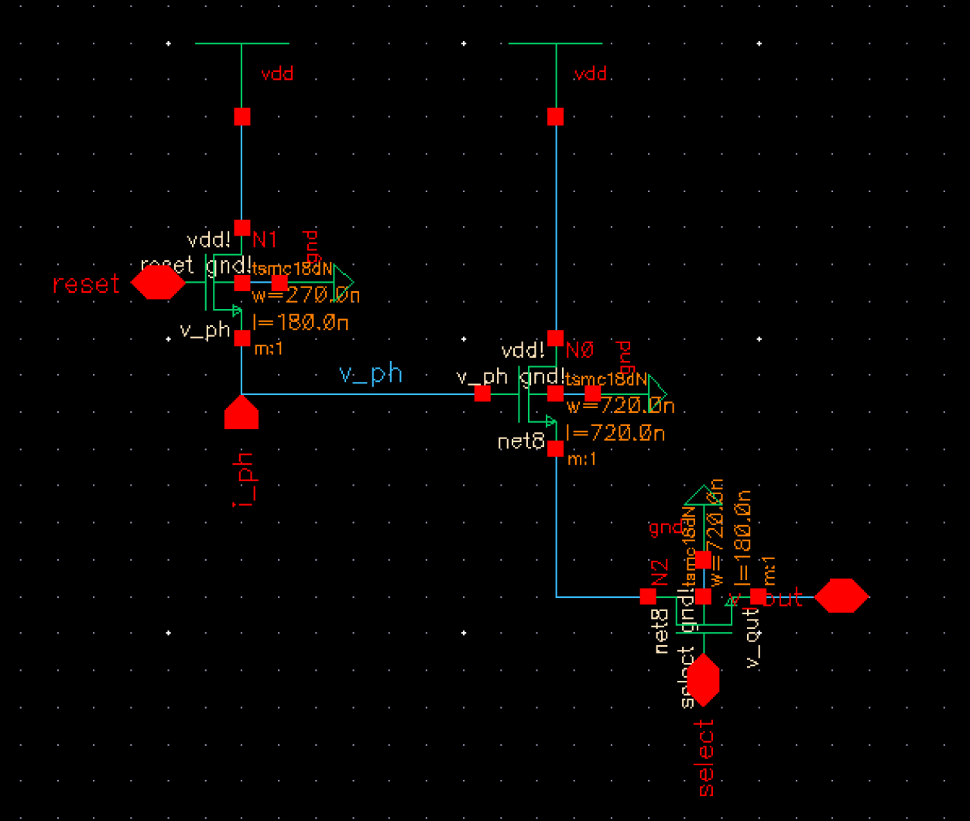
Active Pixel Sensor Schematic
Alexander Shen, Brian Zhou, Hayley Chu
Johns Hopkins University | Department of Electrical and Computer Engineering | Baltimore, MD
This is the schematic for the active pixel sensor.
I chose to set V_{reset} to be V_{dd} to allow for easier design as this was one less factor to consider. I used pins to represent reset, select, and V_{out}. I originally had the current mirror, which simulates the photodiode, integrated in this schematic but we decided to create a separate symbol for it so that we could customize the photocurrent that each photodiode is producing, and also because in the final 4x4 array we’ll need the current mirror symbol.
Contributions
Hayley Chu

Slide 11
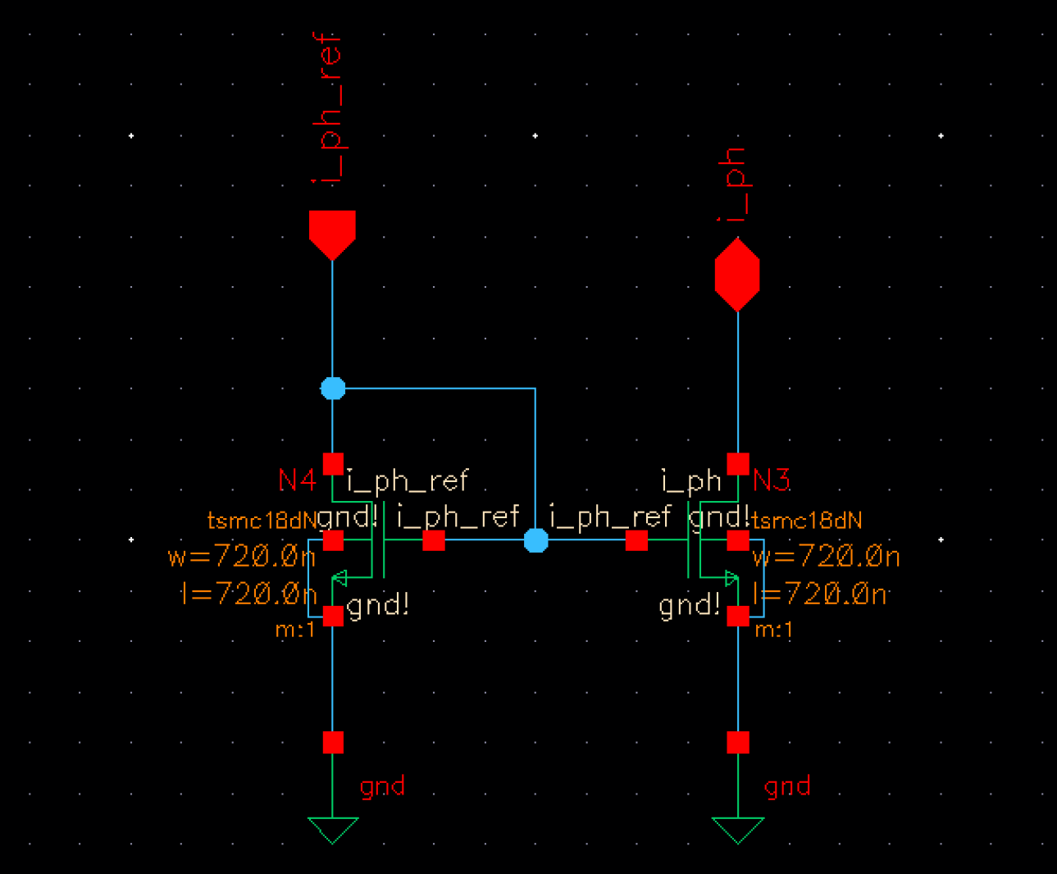
Current Mirror Schematic
Alexander Shen, Brian Zhou, Hayley Chu
Johns Hopkins University | Department of Electrical and Computer Engineering | Baltimore, MD
This is the schematic for the current mirror.
Since Cadence doesn’t have a photodiode component option, I implemented it using a current mirror to deliver the photocurrent to the source follower in the main APS schematic. The input current i_{ph_ref} through transistor N4 sets the common gate voltage and hence the output current i_{ph} of the transistor N3.
Contributions
Hayley Chu

Slide 12
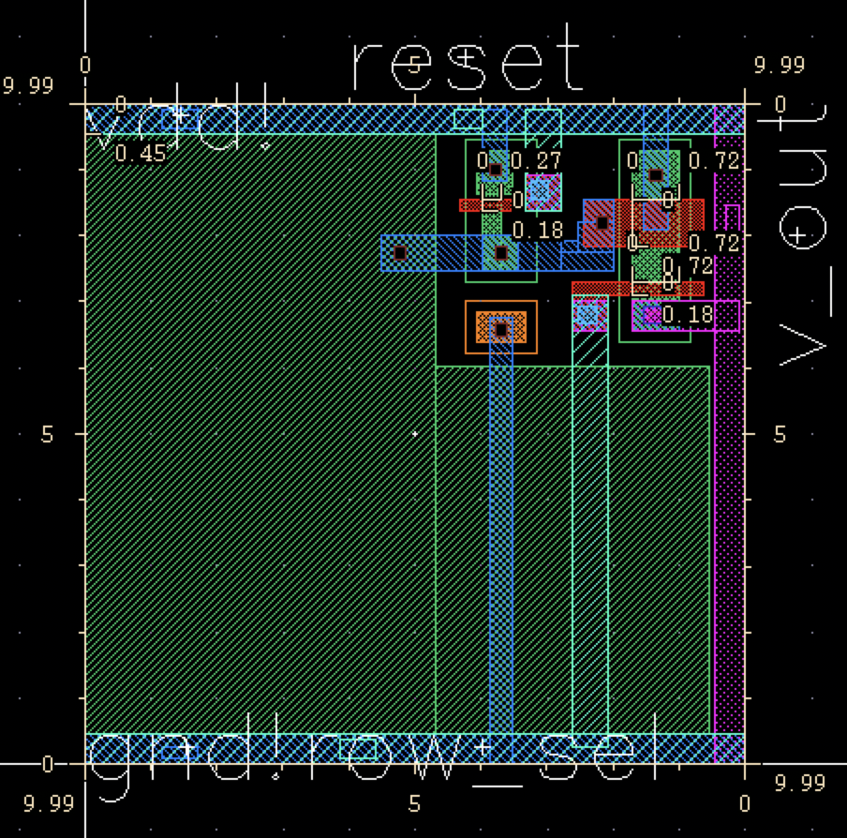
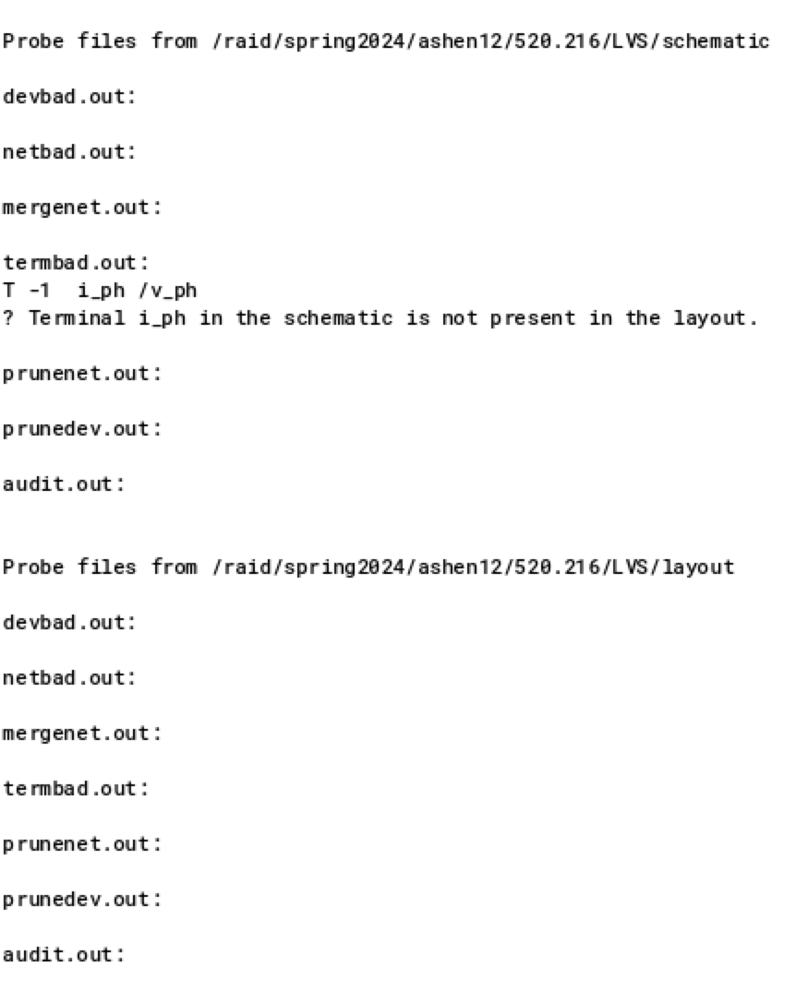
APS Layout and LVS
Alexander Shen, Brian Zhou, Hayley Chu
Johns Hopkins University | Department of Electrical and Computer Engineering | Baltimore, MD
This is the layout for the Active Pixel Sensor.
I decided to stack a lot of components together to maximize the size of the n-well/p-sub photodiode.
We are aware that stacking metal layers can create parasitic capacitances which is why we didn’t stack all the metal layers together to find a balance with the area.
Layout-vs-schematic (LVS): Everything is consistent with the schematic. We can see that there i_ph terminal is not present in the layout. That is because it represents the photo diode.
Contributions
Alexander Shen

Slide 13
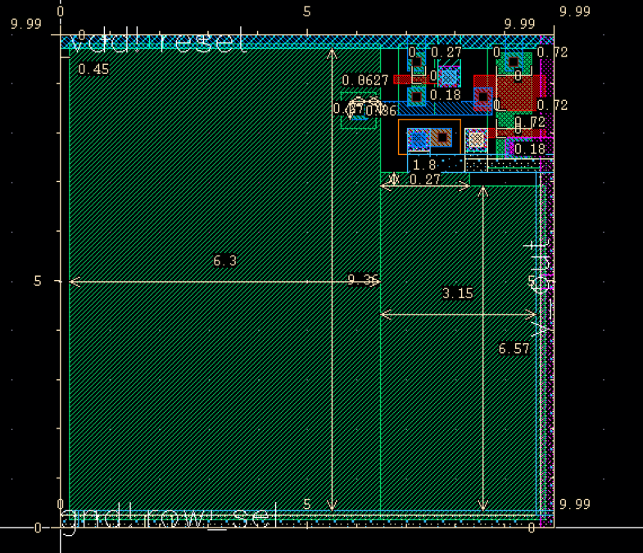
APS Layout Optimization
Alexander Shen, Brian Zhou, Hayley Chu
Johns Hopkins University | Department of Electrical and Computer Engineering | Baltimore, MD
The APS layout is then optimized to maximize the area of the photodiode.
Area of the n-well strictly not covered by other components has reached 79.95% of total cell area.
n-well/p-sub photodiode is chosen because the cell area is fixed, thus there is no need to sacrifice sensitivity for space by using n+/p-sub.
p+/n-well/p-sub photodiode not chosen due Cadence incompatibility.
Contributions
Brian Zhou

Slide 14
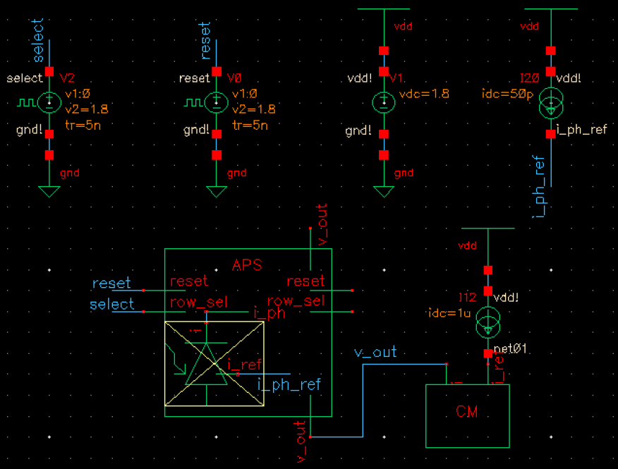
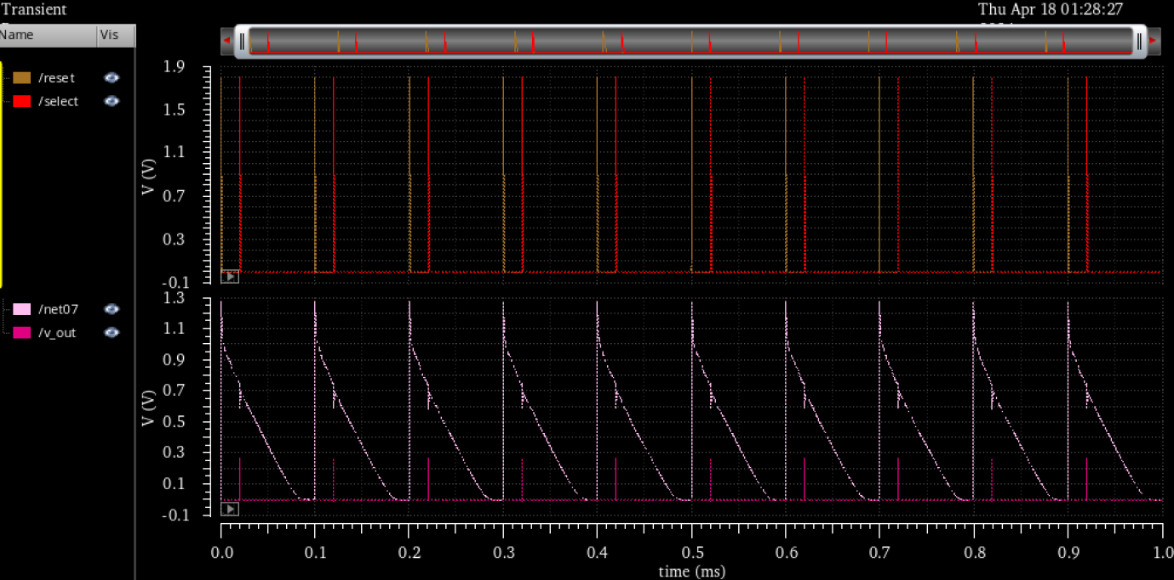
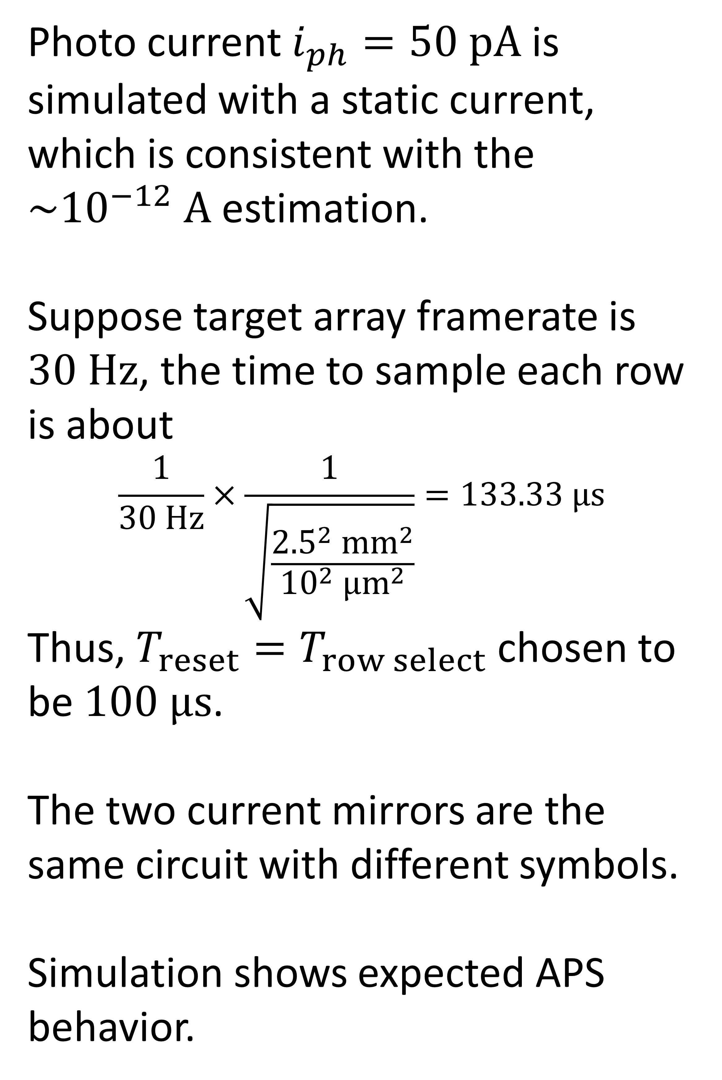
APS Simulation
Alexander Shen, Brian Zhou, Hayley Chu
Johns Hopkins University | Department of Electrical and Computer Engineering | Baltimore, MD
Photo current $i_{ph}=50 pA$ is simulated with a static current, which is consistent with the $\sim {10}^{−12} A$ estimation.
Suppose target array framerate is $30 Hz$, the time to sample each row is about
$$\frac{1}{30 Hz}×\frac{1}{\sqrt{\frac{{2.5}^{2} {mm}^{2}}{{10}^{2} {μm}^{2}}}}=133.33 μs$$
Thus, $T_{reset}=T_{row select}$ chosen to be $100 μs$.
The two current mirrors are the same circuit with different symbols.
Simulation shows expected APS behavior.
Contributions
Brian Zhou

